Slide 1
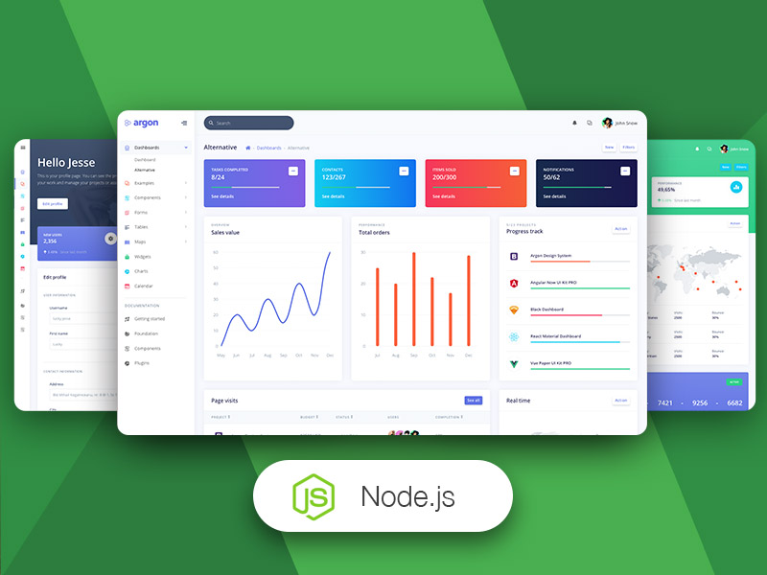
Admin Dashboard
By Akash Rawat
MCA(NIU)

Slide 2
Agenda
1
2
3
4
5
Introduction
Backend Technologies
Building the Backend
Database
Design
Deployment

Slide 3
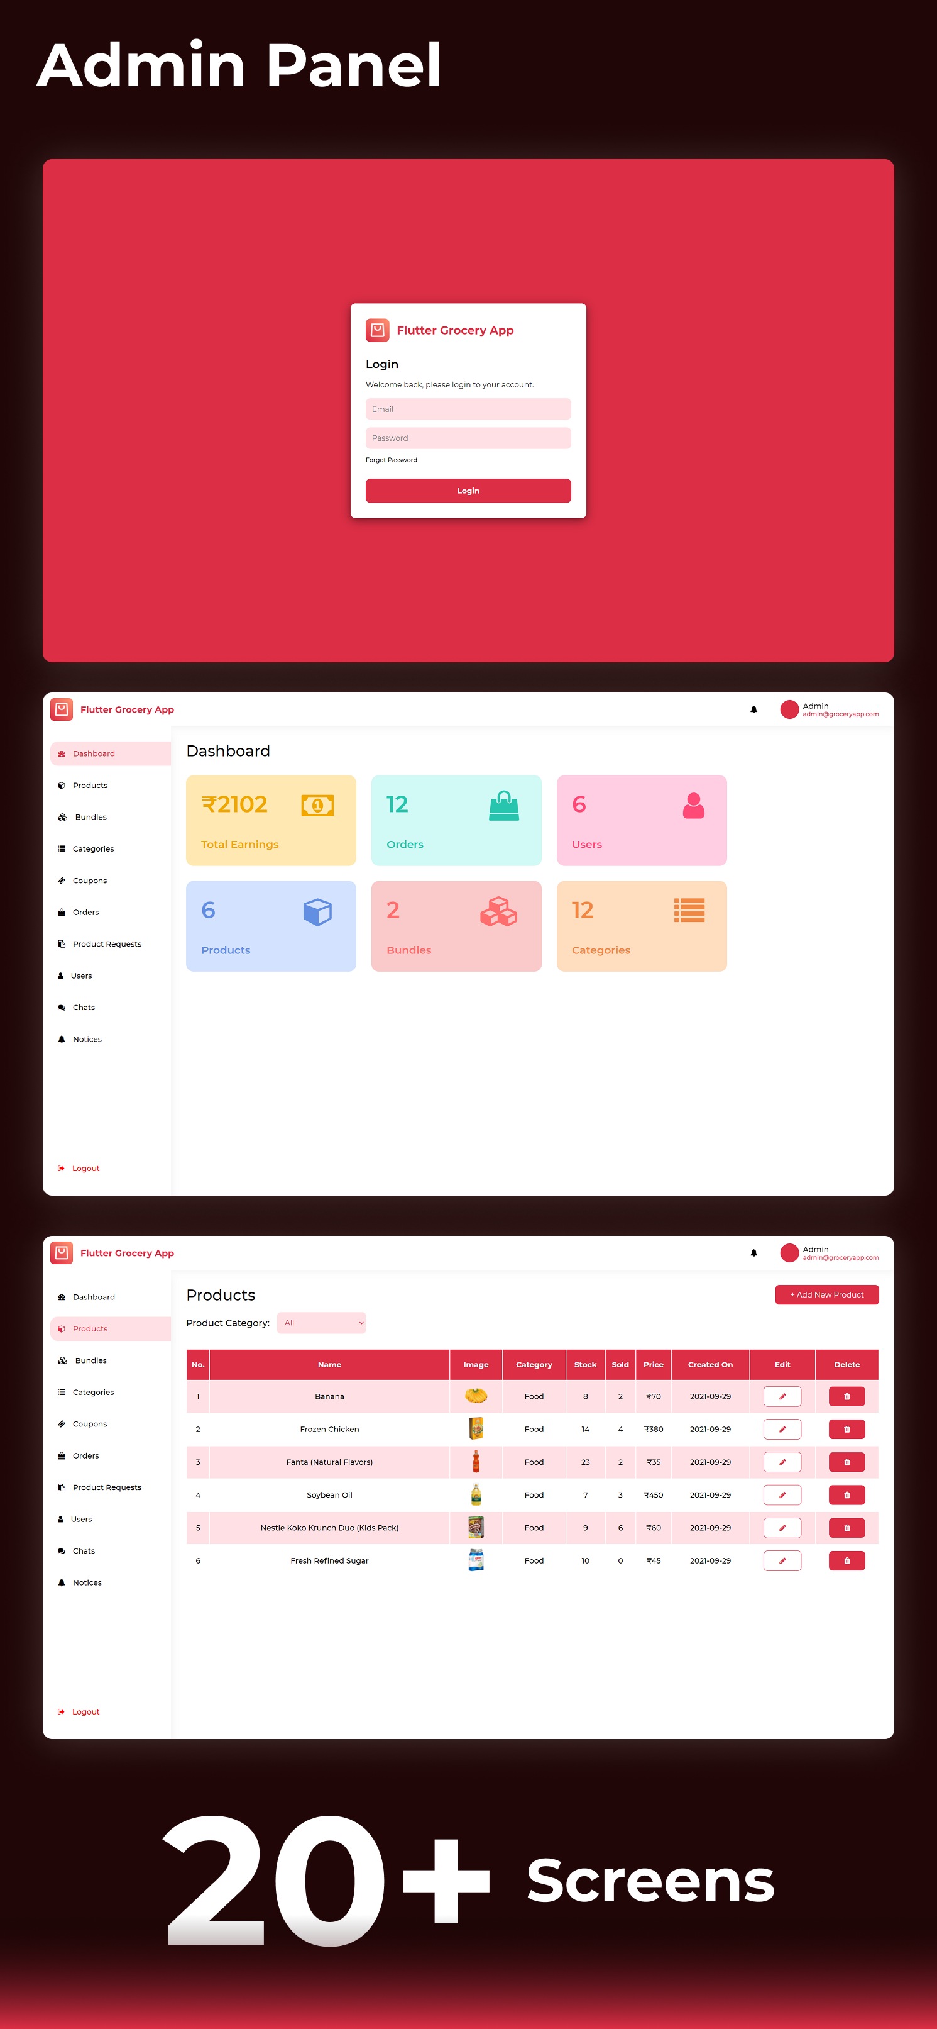

Introduction
An admin dashboard serves as the central command center for managing and overseeing various aspects of a system, application, or organization.
It is a user interface designed specifically for administrators, providing them with a comprehensive overview of critical data and tools necessary to make informed decisions, monitor performance, and maintain the smooth operation of a digital platform or business.

Slide 4
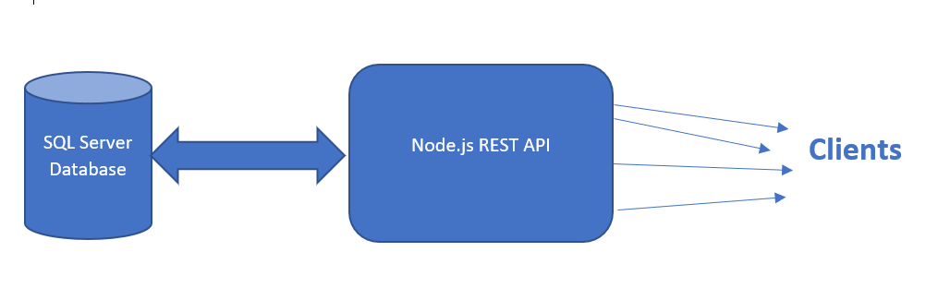
Backend Technologies
The project heavily utilized Node.js for server-side scripting and API development, along with MySQL for data storage and retrieval.
Express.js framework was employed to simplify routing and middleware handling.

Slide 5
Building the Backend
Setting Up the Development Environment:
Begin by installing Node.js on your development machine. Node.js comes with npm (Node Package Manager), which allows you to manage libraries and dependencies for your project.
Choose an SQL database system (e.g., MySQL, PostgreSQL, SQLite) and set it up locally or on a remote server. Install any necessary database management tools as well.
Selecting a Web Framework:
Consider using a web framework like Express.js, which simplifies the process of building the backend by providing a structured and efficient way to handle HTTP requests, routing, and middleware.

Slide 6
Database Design
Database Schema Design
Database design is the systematic process of creating a structured and efficient data storage and retrieval system.
Tables and Relationships
It involves defining the structure of the database by specifying tables, columns, keys, and relationships.
Tables: Tables represent entities or categories of data and consist of rows and columns.
Relationships: Relationships define how different tables are connected or related to each other within the database.
The most common types of relationships are one-to-one, one-to-many, and many-to-many. Establishing these relationships is essential for maintaining data integrity and enabling complex queries.

Slide 7
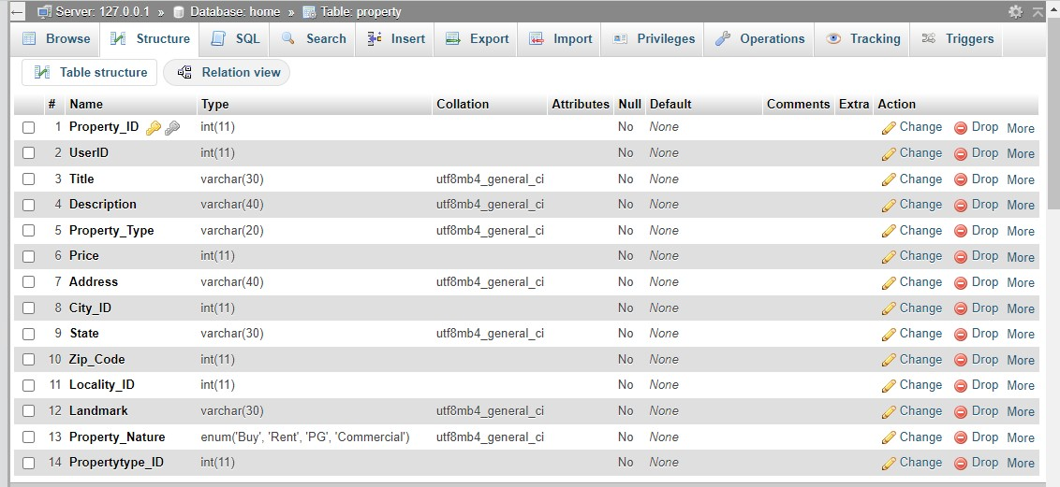

Slide 8
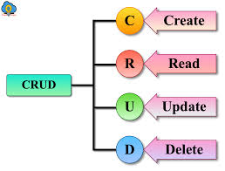
API Endpoints
API endpoints are specific URLs within a web application or service that enable clients (such as web browsers, mobile apps, or other software) to interact with and access specific functionalities or resources.
CRUD operations represent the four fundamental actions that can be performed on resources through API endpoints:

Slide 9
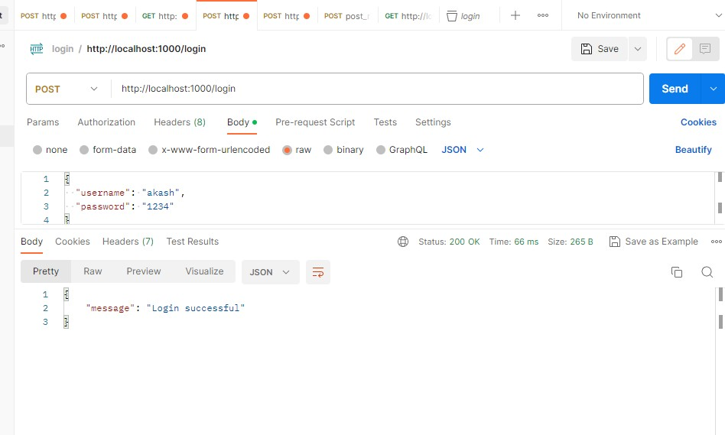
API (Application Programming Interface)

Slide 10
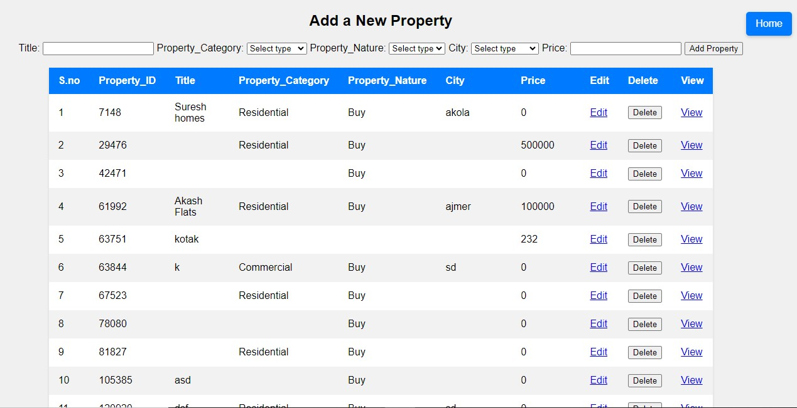
CRUD

Slide 11
Deployment
Deploying a Node.js admin dashboard is a crucial step in making your application accessible to users.
Ngrok is a convenient way to quickly expose your locally hosted dashboard to the internet, allowing remote access for testing and sharing with others.
Ngrok creates a secure tunnel from your local development environment to the public internet, providing a temporary public URL for your application.

Slide 12
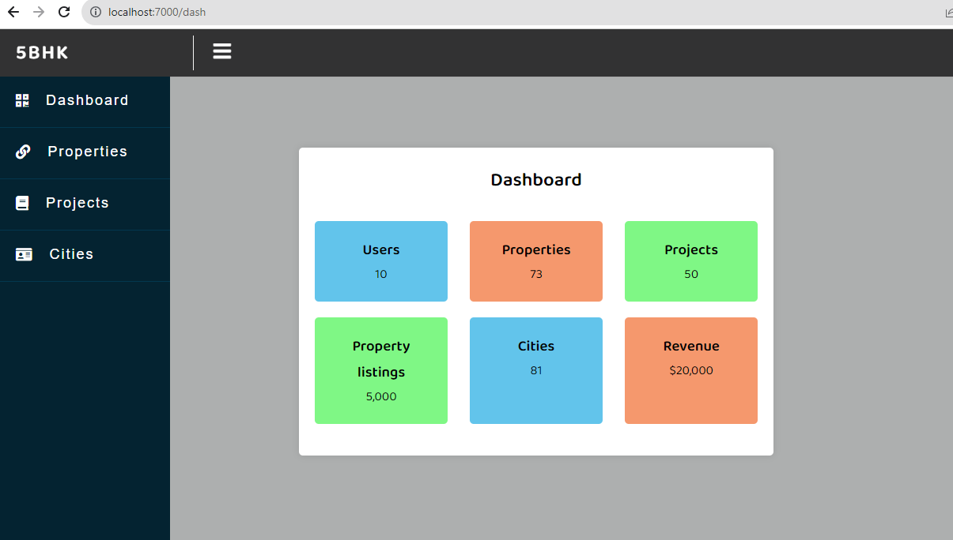

Slide 13
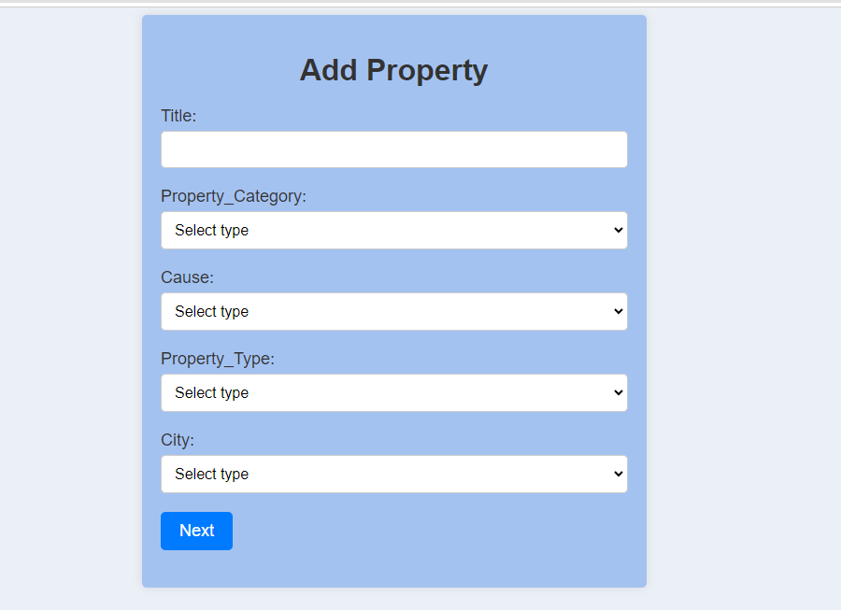

Slide 14

Summary
This project aimed to develop the backend infrastructure for a web-based application. The application facilitated user registration, authentication, data retrieval, and manipulation. The primary focus was on creating RESTful APIs to serve client-side requests and managing the associated database interactions.

Slide 15


Thank you
Akash Rawat
Mca22.akash.rawat@sunstone.edu.in

